Slide 1


Titolo presentazione sottotitolo
Parallel programming project
Milano, XX mese 20XX
Academic year 2020/2021 Simone Tomè
Prof. Fabrizio Ferrandi

Slide 2
Table of contents
Algorithm description
Complexity analysis
Used technologies
Testing correctness
Performance benchmarks
Conclusions

Slide 3
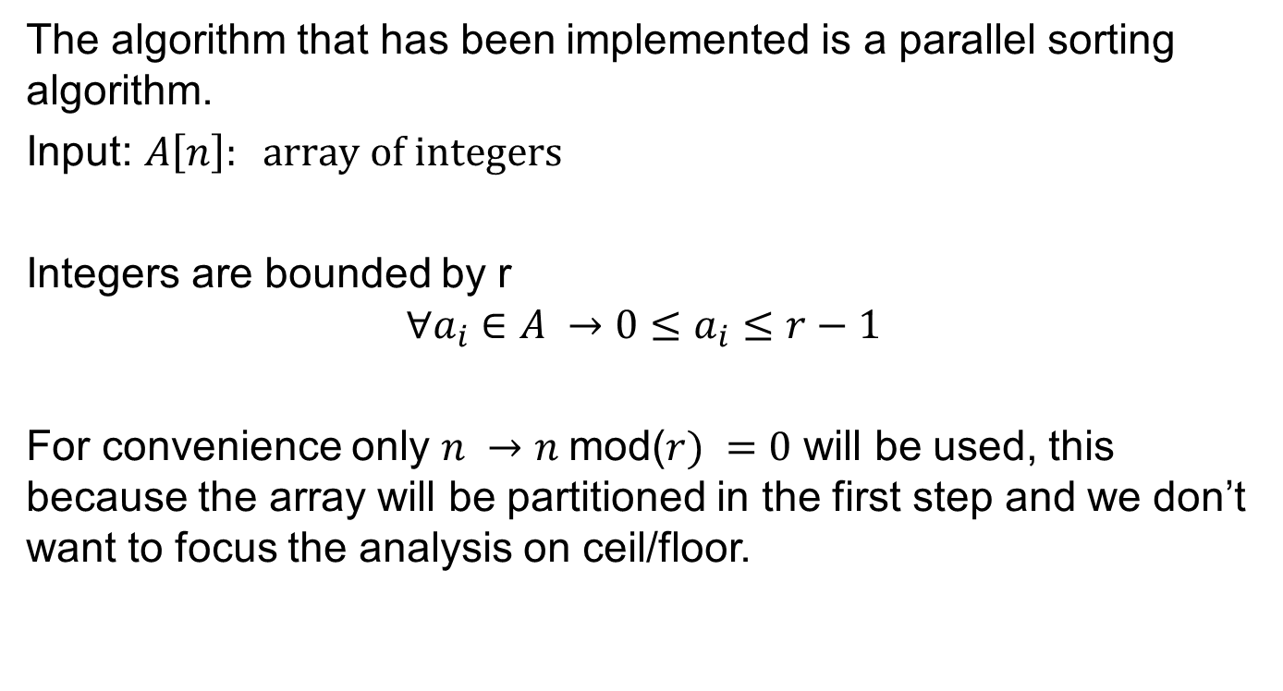
Algorithm description
The algorithm that has been implemented is a parallel sorting algorithm.
Input: $A\left[n\right]: array of integers$
Integers are bounded by r
$$∀a_{i}∈A →0≤a_{i}≤r−1$$
For convenience only $n →n$mod($r) =0$ will be used, this because the array will be partitioned in the first step and we don’t want to focus the analysis on ceil/floor.

Slide 4

Algorithm description
First step
Partition the array A[n] into $\frac{n}{r}$ subarrays:
$$∀i∈\left\{0,..,\frac{n}{r}−1\right\}→B_{i}=A[ir,..,ir+r−1]$$
$$B_{0}=A\left[0,..,r−1\right]$$
$$B_{1}=A[r,..,2r−1]$$
…
$B_{\frac{n}{r}−1}=A[n−r,..,n−1]$

Slide 5
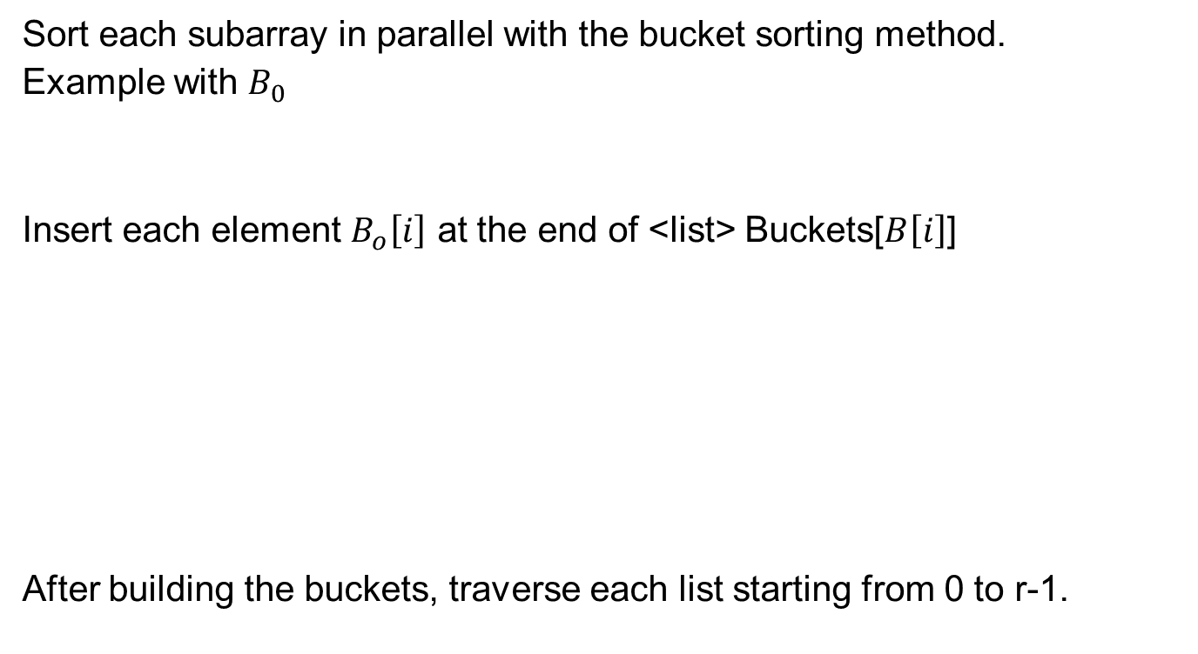
Algorithm description
Sort each subarray in parallel with the bucket sorting method.
Example with $B_{0}$
Insert each element $B_{o}\left[i\right]$ at the end of <list> Buckets[$B\left[i\right]$]
After building the buckets, traverse each list starting from 0 to r-1.
2 | 1 | 0 | 2
0
1
2
3
0
1
0 | 1 | 2 | 2
2
2

Slide 6
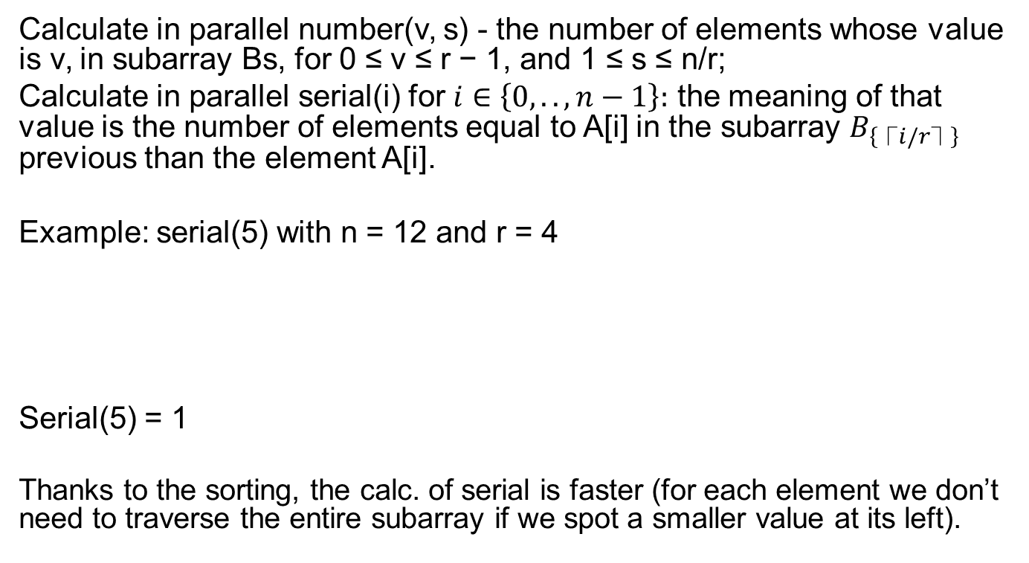
Algorithm description
Calculate in parallel number(v, s) - the number of elements whose value is v, in subarray Bs, for 0 ≤ v ≤ r − 1, and 1 ≤ s ≤ n/r;
Calculate in parallel serial(i) for $i∈\left\{0,..,n−1\right\}:$ the meaning of that value is the number of elements equal to A[i] in the subarray $B_{\left\{⎾i/r⏋\right\}}$ previous than the element A[i].
Example: serial(5) with n = 12 and r = 4
Serial(5) = 1
Thanks to the sorting, the calc. of serial is faster (for each element we don’t need to traverse the entire subarray if we spot a smaller value at its left).
0 | 1 | 2 | 2 | 0 | 0 | 0 | 1 | 1 | 2 | 3 | 3

Slide 7
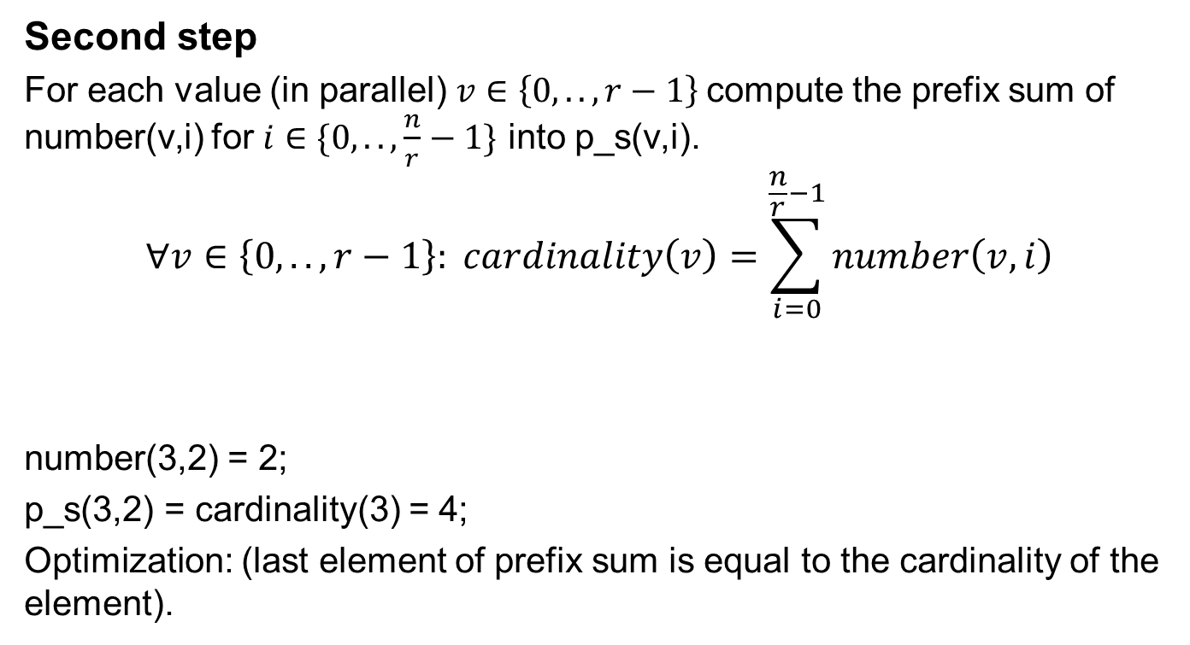
Algorithm description
Second step
For each value (in parallel) $v∈\left\{0,..,r−1\right\}$compute the prefix sum of number(v,i) for $i∈\{0,..,\frac{n}{r}−1\}$ into p_s(v,i).
$$∀v∈\left\{0,..,r−1\right\}: cardinality\left(v\right)=\sum_{i=0}^{\frac{n}{r}−1}{number\left(v,i\right)}$$
number(3,2) = 2;
p_s(3,2) = cardinality(3) = 4;
Optimization: (last element of prefix sum is equal to the cardinality of the element).
0 | 1 | 2 | 3 | 0 | 0 | 1 | 3 | 1 | 2 | 3 | 3

Slide 8
Algorithm description
Step 3
Compute the prefix sum of the sequence of cardinalities: cardinality(0),..,cardinality(r-1) into global(0),..,global(r-1).
Cardinalities:
0 | 1 | 2 | 3 | 0 | 0 | 1 | 3 | 1 | 2 | 3 | 3
3 | 3 | 2 | 4
3 | 6 | 8 | 12

Slide 9
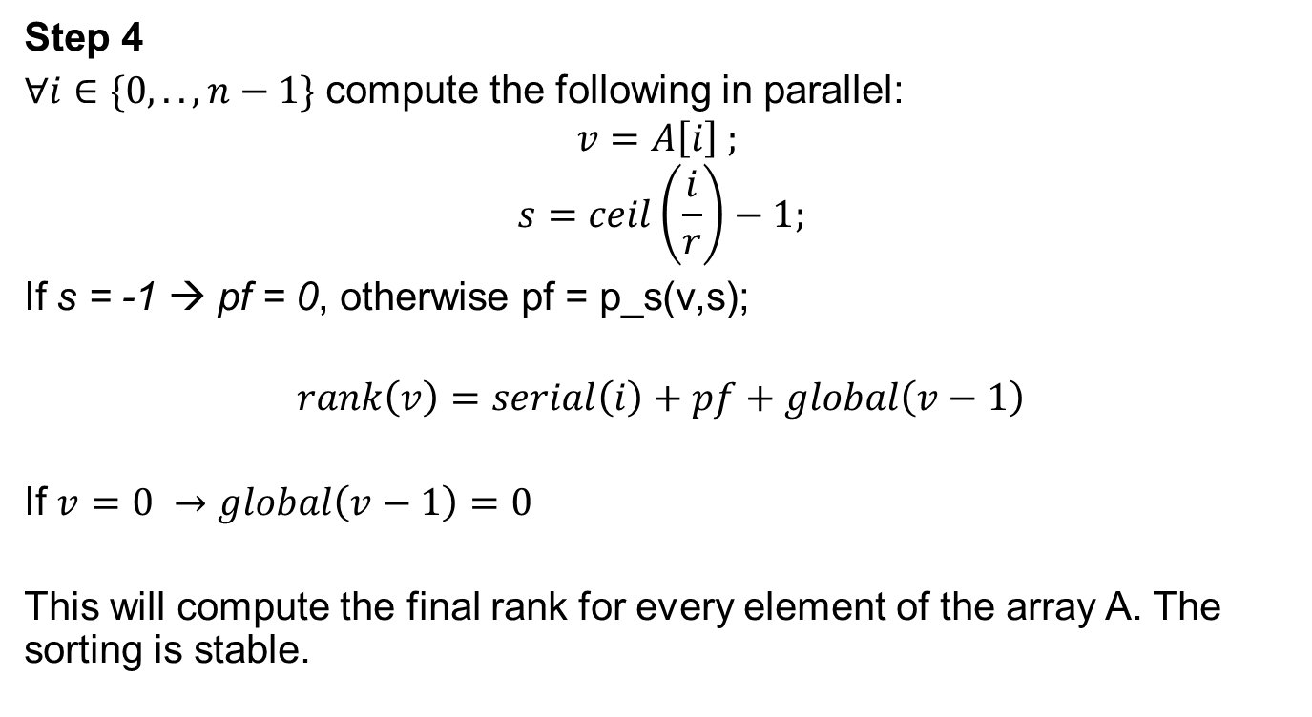
Algorithm description
Step 4
$∀i∈\{0,..,n−1\}$ compute the following in parallel:
$$v=A\left[i\right] ;$$
$$s=ceil\left(\frac{i}{r}\right)−1;$$
If s = -1 → pf = 0, otherwise pf = p_s(v,s);
$$rank\left(v\right)=serial\left(i\right)+pf+global\left(v−1\right)$$
If $v=0 →global\left(v−1\right)=0$
This will compute the final rank for every element of the array A. The sorting is stable.

Slide 10
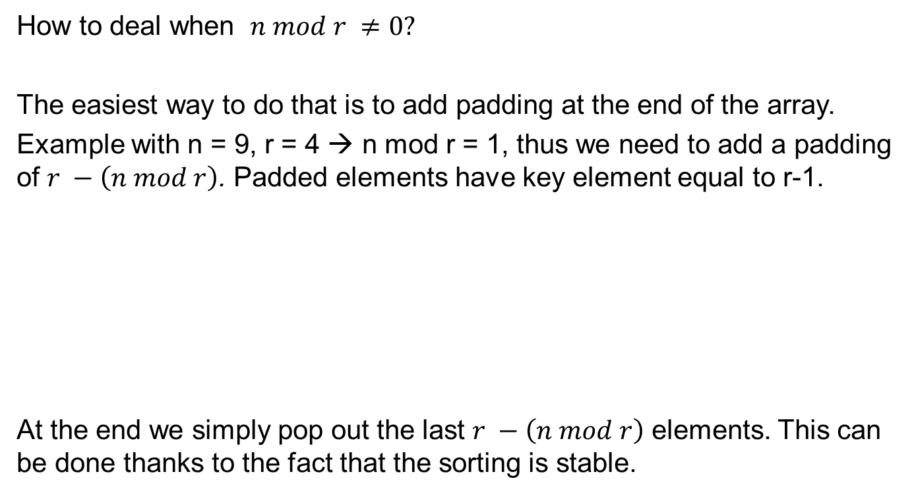
Algorithm description
How to deal when $n mod r ≠0?$
The easiest way to do that is to add padding at the end of the array.
Example with n = 9, r = 4 → n mod r = 1, thus we need to add a padding of $r −\left(n mod r\right)$. Padded elements have key element equal to r-1.
At the end we simply pop out the last $r −\left(n mod r\right)$ elements. This can be done thanks to the fact that the sorting is stable.
3 | 1 | 0 | 1 | 2 | 1 | 0 | 3 | 2
3 | 1 | 0 | 1 | 2 | 1 | 0 | 3 | 2 | 3 | 3 | 3

Slide 11
Note: how to prefix sum
1 | 1 | 1 | 1 | 1
+
+
+
+
1 | 2 | 2 | 2 | 2
Highlighted boxes shows the magnitude of the “range” value, which doubles at each iteration.
At each iteration we sum starting from an offset index, which is equal to the range value.
+
+
+
1 | 2 | 3 | 4 | 4
Offset index
+
1 | 2 | 3 | 4 | 5

Slide 12
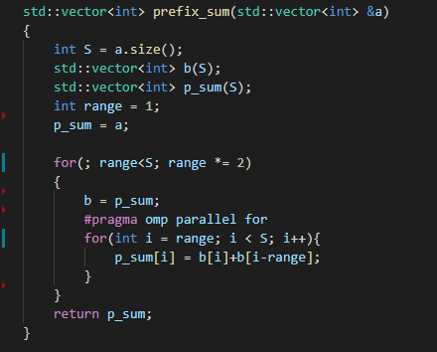
Note: how to prefix sum
Implementation of the prefix sum with Openmp.

Slide 13
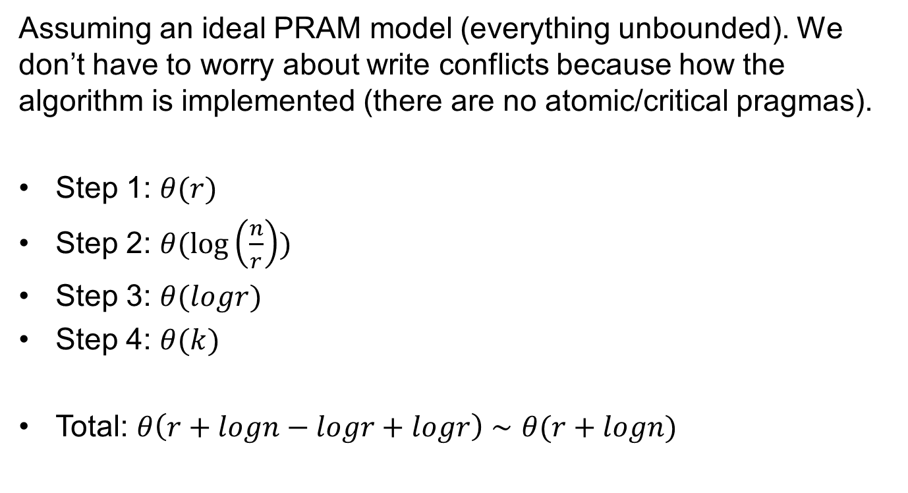
Complexity analysis
Assuming an ideal PRAM model (everything unbounded). We don’t have to worry about write conflicts because how the algorithm is implemented (there are no atomic/critical pragmas).
Step 1: $θ(r)$
Step 2: $θ(\log\left(\frac{n}{r}\right))$
Step 3: $θ(logr)$
Step 4: $θ(k)$
Total: $θ\left(r+logn−logr+logr\right)∼θ(r+logn)$

Slide 14

Complexity analysis
The serial complexity is the following:
Step 1: $θ(nr)$
Step 2: $θ(n)$
Step 3: $θ(r)$
Step 4: $θ(n)$
Total: $θ\left(nr+n+r\right)∼θ(nr)$

Slide 15
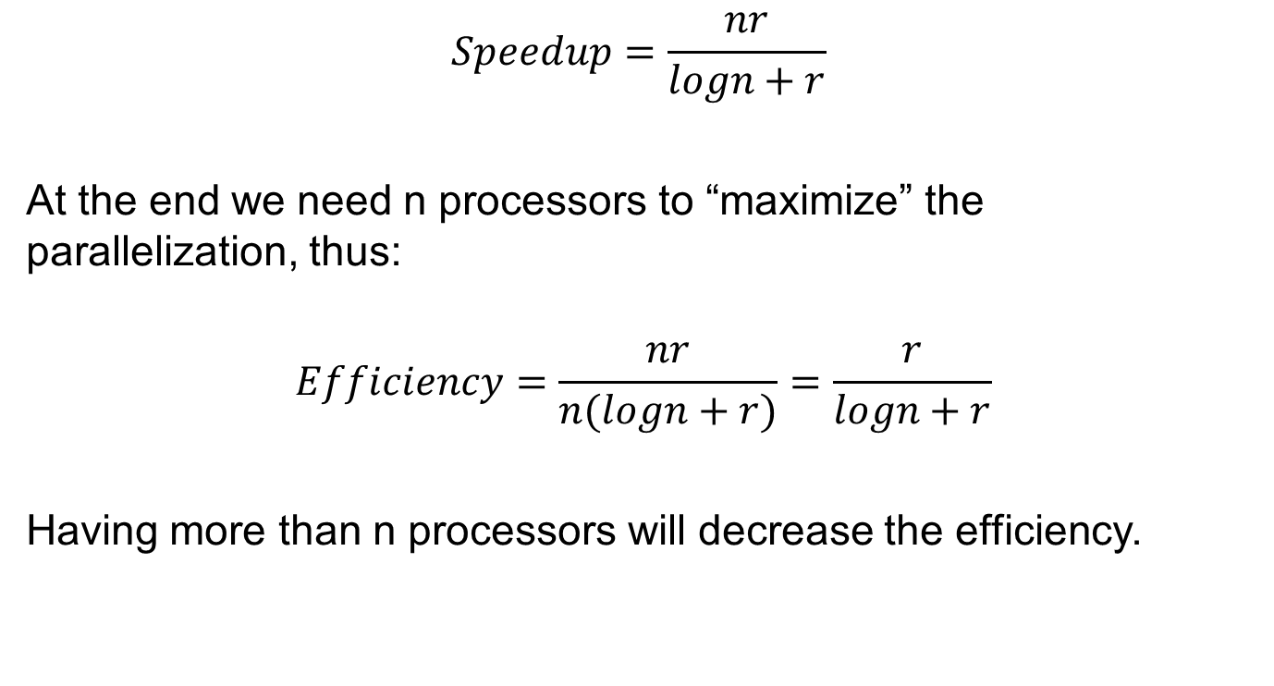
PRAM
$$Speedup=\frac{nr}{logn+r}$$
At the end we need n processors to “maximize” the parallelization, thus:
$$Efficiency=\frac{nr}{n(logn+r)}=\frac{r}{logn+r}$$
Having more than n processors will decrease the efficiency.

Slide 16
Used technologies
C++ 11;
g++ compiler;
OpenMP;
Valgrind for heap usage profiling;
Benchmark library by Google for time performance profiling;
All benchmarks have been made on a i7 4790k (4 physical cores) with 8Gb of RAM, using WSL Ubuntu for Windows 10 and setting the CPU to high performance (clock’s frequency fixed to 4.2 GHz)

Slide 17
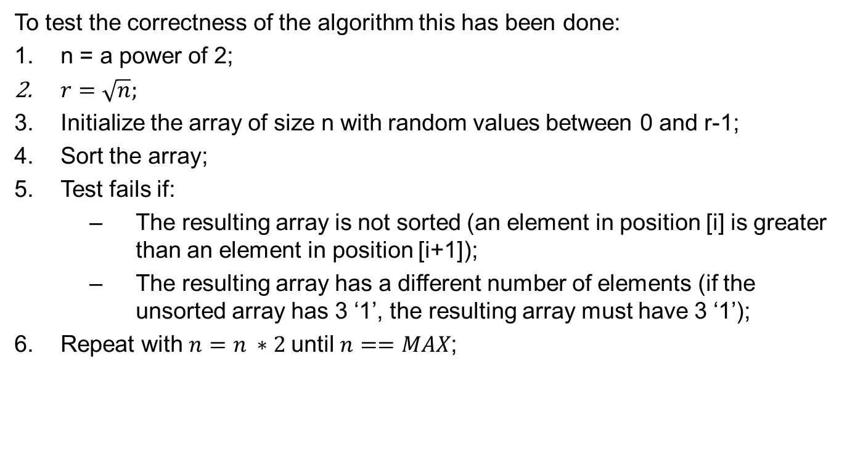
Testing correctness
To test the correctness of the algorithm this has been done:
n = a power of 2;
$r=\sqrt{n};$
Initialize the array of size n with random values between 0 and r-1;
Sort the array;
Test fails if:
The resulting array is not sorted (an element in position [i] is greater than an element in position [i+1]);
The resulting array has a different number of elements (if the unsorted array has 3 ‘1’, the resulting array must have 3 ‘1’);
Repeat with $n=n ∗2$until $n==MAX$;

Slide 18
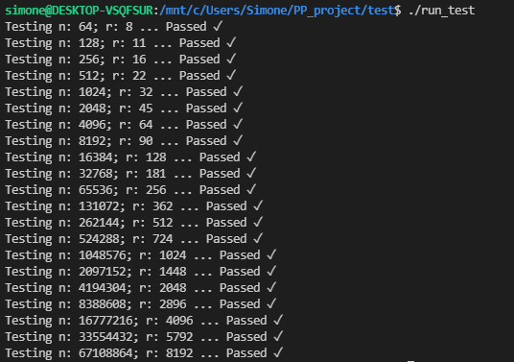
Testing correctness
Run the test:

Slide 19
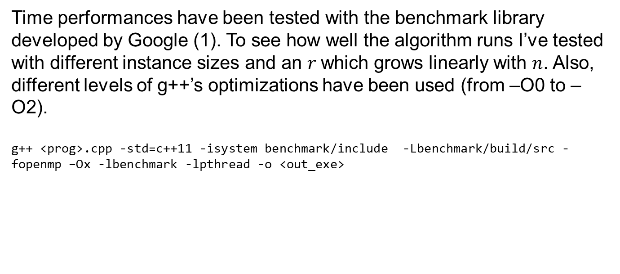
Performance analysis
Time performances have been tested with the benchmark library developed by Google (1). To see how well the algorithm runs I’ve tested with different instance sizes and an $r$which grows linearly with $n$. Also, different levels of g++’s optimizations have been used (from –O0 to –O2).
g++ <prog>.cpp -std=c++11 -isystem benchmark/include -Lbenchmark/build/src -fopenmp –Ox -lbenchmark -lpthread -o <out_exe>
lvl. of optimization
(1): google/benchmark: A microbenchmark support library (github.com)

Slide 20
Performance analysis
Test cases: arrays of size n, with integers in the range {0,..,r-1}. Arrays are initialized randomly using rand() function (uniform distribution).
The considered time is the total CPU time, not the wall one.
Console outputs are saved in the project repository:
Filename – output.txt

Slide 21
Performance analysis –O0 optimization
Instance size (N) | R | 1 thread | 2 threads | 4 threads | 8 threads | 16 threads
262144 | 128 | 109375000 | 61079545 | 36458333 | 31250000 | 46875000
524288 | 256 | 229166667 | 125000000 | 76388889 | 56818182 | 74776786
1048576 | 512 | 445312500 | 239583333 | 152343750 | 122395833 | 175000000
2097152 | 1024 | 906250000 | 507812500 | 289062500 | 213541667 | 291666667
4194304 | 2048 | 1843750000 | 1000000000 | 640625000 | 437500000 | 500000000
8388608 | 4096 | 3750000000 | 2125000000 | 1281250000 | 906250000 | 1171875000
16777216 | 8192 | 7640625000 | 4187500000 | 2609375000 | 1953125000 | 2468750000
33554432 | 16384 | 1.5547E+10 | 8875000000 | 5750000000 | 3906250000 | 5062500000
67108864 | 32768 | 3.3063E+10 | 18718750000 | 1.2484E+10 | 8640625000 | 10234375000
134217728 | 65536 | 7.3281E+10 | 41218750000 | 2.7266E+10 | 1.7609E+10 | 20359375000
Time in nanoseconds

Slide 22
Performance analysis –O0 optimization

Slide 23
Performance analysis –O1 optimization
Instance size (N) | R | 1 thread | 2 threads | 4 threads | 8 threads | 16 threads
262144 | 128 | 20507813 | 14687500 | 11230469 | 10602679 | 24784483
524288 | 256 | 41360294 | 27644231 | 20220588 | 21484375 | 57812500
1048576 | 512 | 88541667 | 61079545 | 44117647 | 46875000 | 104687500
2097152 | 1024 | 197916667 | 138020833 | 102678571 | 84821429 | 207031250
4194304 | 2048 | 453125000 | 281250000 | 171875000 | 171875000 | 398437500
8388608 | 4096 | 1000000000 | 609375000 | 406250000 | 367187500 | 718750000
16777216 | 8192 | 2062500000 | 1359375000 | 890625000 | 812500000 | 1875000000
33554432 | 16384 | 4484375000 | 2812500000 | 2015625000 | 1812500000 | 3687500000
67108864 | 32768 | 1.0969E+10 | 6875000000 | 4843750000 | 4859375000 | 8062500000
134217728 | 65536 | 2.8156E+10 | 16687500000 | 1.2578E+10 | 1.1672E+10 | 17187500000
Time in nanoseconds

Slide 24
Performance analysis –O1 optimization

Slide 25
Performance analysis –O2 optimization
Instance size (N) | R | 1 thread | 2 threads | 4 threads | 8 threads | 16 threads
262144 | 128 | 17736486 | 14062500 | 11230469 | 15997024 | 21739130
524288 | 256 | 36184211 | 26875000 | 21599265 | 23437500 | 58894231
1048576 | 512 | 87053571 | 53977273 | 44117647 | 45833333 | 95486111
2097152 | 1024 | 203125000 | 128125000 | 91145833 | 93750000 | 244791667
4194304 | 2048 | 562500000 | 335937500 | 177083333 | 171875000 | 406250000
8388608 | 4096 | 1109375000 | 625000000 | 398437500 | 382812500 | 781250000
16777216 | 8192 | 2312500000 | 1546875000 | 921875000 | 875000000 | 1968750000
33554432 | 16384 | 4718750000 | 3375000000 | 2046875000 | 1984375000 | 3968750000
67108864 | 32768 | 1.125E+10 | 7359375000 | 4984375000 | 4890625000 | 8250000000
134217728 | 65536 | 3.0016E+10 | 22390625000 | 1.3375E+10 | 1.3266E+10 | 17937500000
Time in nanoseconds

Slide 26
Performance analysis –O2 optimization

Slide 27
Performance analysis –O3 optimization
Instance size (N) | R | 1 thread | 2 threads | 4 threads | 8 threads | 16 threads
262144 | 128 | 16768293 | 13125000 | 10602679 | 10833333 | 21484375
524288 | 256 | 32738095 | 24038462 | 20019531 | 22949219 | 54687500
1048576 | 512 | 78125000 | 62500000 | 43945312 | 46875000 | 106534091
2097152 | 1024 | 179687500 | 122395833 | 86805556 | 87053571 | 177083333
4194304 | 2048 | 414062500 | 265625000 | 171875000 | 171875000 | 335937500
8388608 | 4096 | 890625000 | 562500000 | 390625000 | 343750000 | 906250000
16777216 | 8192 | 1843750000 | 1343750000 | 828125000 | 859375000 | 1562500000
33554432 | 16384 | 4109375000 | 3140625000 | 2125000000 | 1890625000 | 3859375000
67108864 | 32768 | 1.0516E+10 | 8312500000 | 4671875000 | 5031250000 | 7750000000
134217728 | 65536 | 2.9953E+10 | 18578125000 | 1.3984E+10 | 1.275E+10 | 15906250000
Time in nanoseconds

Slide 28
Performance analysis –O3 optimization

Slide 29
Memory usage
To profile the memory usage of the program I’ve used Valgrind, a useful tool to detect memory leaks and the total usage of the heap (dynamic allocated memory).
To do this the program must run under this command:
$ valgrind ./<prog_name>
To avoid any possible memory optimization I’ve compiled the .cpp without using –Ox options.

Slide 30
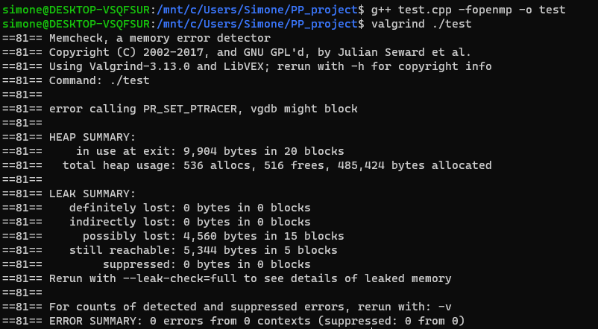
Memory usage
The program will run under the supervision of valgrind and at the end it will print on the console something like that:
474 KB allocated

Slide 31

Memory usage
Instance size (N) | R | Memory usage (MB)
100 | 10 | 0.11328125
500 | 25 | 0.15018082
1000 | 50 | 0.17277908
5000 | 100 | 0.43932724
10000 | 100 | 0.7455101
50000 | 250 | 3.28728485
100000 | 250 | 6.43218613
500000 | 500 | 31.6703224
1000000 | 1000 | 63.1802635
5000000 | 2500 | 315.390152
10000000 | 2500 | 630.232704
Use case assumption: R grows $∼θ(\sqrt{N})$
It’s easy to see that the memory usage is linear w.r.t. the instance size, not particularly surprising, but it’s an indicator that it can scale well. The space complexity is Θ(n), considering n >> r.

Slide 32
Memory usage

Slide 33
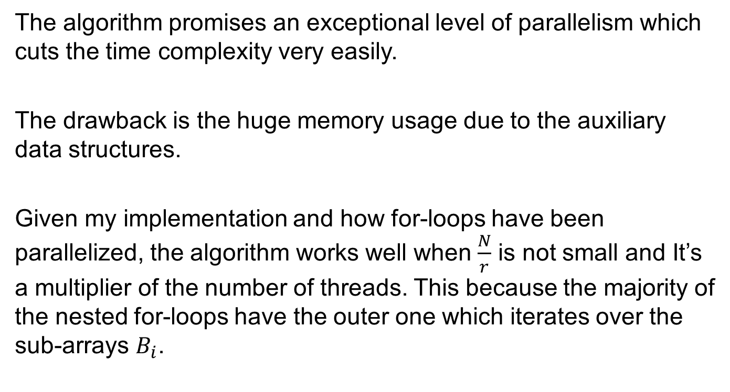
Conclusions
The algorithm promises an exceptional level of parallelism which cuts the time complexity very easily.
The drawback is the huge memory usage due to the auxiliary data structures.
Given my implementation and how for-loops have been parallelized, the algorithm works well when $\frac{N}{r}$ is not small and It’s a multiplier of the number of threads. This because the majority of the nested for-loops have the outer one which iterates over the sub-arrays $B_{i}$.

